Slide 1
R for Data Science
Black Friday Sales Prediction
Group 1
Name | Roll Number | Contribution (%)
Aruna Maurya | AM.EN.U4CSE16113 | 25
Srinivas Machiraju | AM.EN.U4CSE16506 | 25
Venu Vardhan | AM.EN.U4CSE16508 | 25
Mohit Hooda | AM.EN.U4CSE16241 | 25

Slide 2
Executive Summary
Everything in the world today is data-driven, and being able to harness this data to draw meaningful insights to learn, analyze and improve upon business models is what we strive to achieve.
Having said that, this report will touch upon the problem statement description, a brief description of the data, its source and its key characteristics followed by the findings from the application of different data mining models.
We have also tried different types of models to compare and contrast and see the difference in results as an accuracy measure. The best among all was XGBoost.

Slide 3
Problem Description
A retail company “ABC Private Limited” wants to understand the customer purchase behavior (specifically, purchase amount) against various products of different categories. They have shared purchase summary of various customers for selected high volume products from last month. The data set also contains customer demographics (age, gender, marital status, city_type, stay_in_current_city), product details (product_id and product category) and Total purchase_amount from last month.
Now, they want to build a model to predict the purchase amount of customer against various products which will help them to create a personalized offer for customers against different products.

Slide 4
Data Description
User_ID: User ID
Product_ID: Product ID
Gender: Sex of User
Age: Age in bins
Occupation: Occupation
City_Category: Category of the city(A, B, C)
Stay_In_Current_City_Yearscity: Number of years stay in current
Marital_Status: Marital Status
Product_Category_1: Product Category (Masked)
Product_Category_2 : Product may belong to another category also (Masked)
Product_Category_3: Product may belong to another category also (Masked)
Purchase: Purchase Amount (Target Variable)

Slide 5
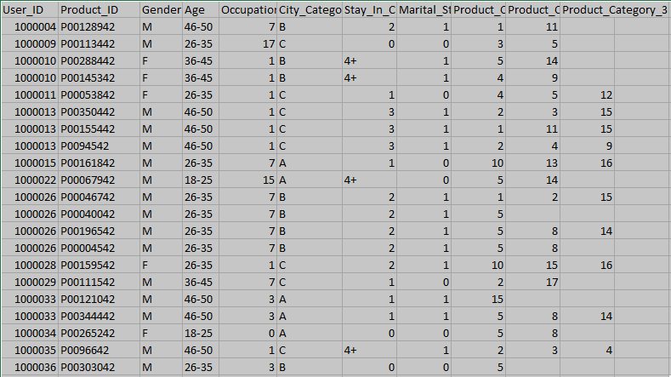
Data Snippet

Slide 6
Data Preprocessing
Data cleansing was achieved after obtaining the summary of the dataset followed by a thorough check of any missing values. Missing values were later replaced by integer 20 as missing values can cause problems in the training phase if not taken care of before.
Data were partitioned and all the string data types were changed to integer. One hot encoding features of the training and testing dataset as some columns are of string type.

Slide 7
Machine Learning Models
We have implemented four models for the prediction
Linear Regression Model
Decision Tree Modelling
SVM
XGBoost
Out of which, Decision Tree and XGBoost yielded good results. So, we took an weighted average of both the the predictions and generated our result.
submit_final$Purchase <- (submit_dc$Purchase + 2*submit_xg$Purchase)/3

Slide 8
Comparative Results
Name of the classifier | Initial Accuracy | Accuracy after Data Preprocessing
Linear Regression | 6168.147 | 5599.195
Decision Tree | 4653.5352 | 3404.233
SVM | 6431.296 | ---
XGBoost | 2786.564 | 2654.343
WA(XGBoost, DT) | --- | 2620.962

Slide 9
Conclusion
XGBoost
AV LB Username: | srinivasmachiraju
AV LB Rank: | 520
AV LB Score: | 2620.962

Slide 10
